Slide 1
WorkshopPLUS - Windows Server: Vital Signs Part 1
Notes:
Version: 12/21/2018 18:22:55

Slide 2
Disclaimer

Slide 3
Physical Memory

Slide 4
Learning Units covered in this Module
Commited Memory Working Sets of Processes Analysis of OS RAM

Slide 5
Commited Memory

Slide 6
Learnings covered in this Unit
Terminology
Commit limit
What is a page file?
Crash dumps and the size of the page files

Slide 7
Terminology

Slide 8

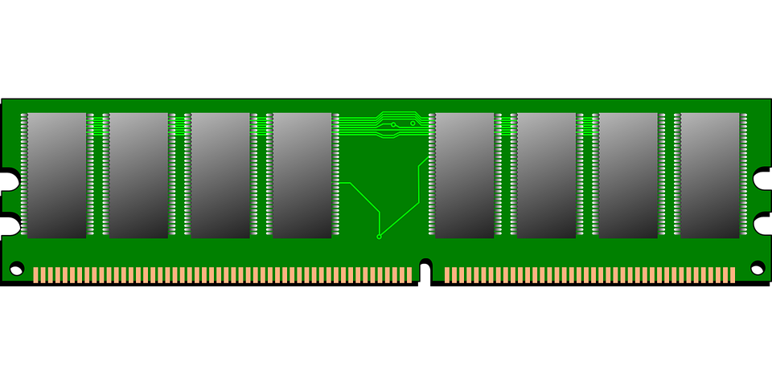
Terminology
Page: The smallest unit of memory that Windows can address. In the 32-bit and 64-bit versions of Windows and Windows Server, the pages are 4 KB
Physical memory: RAM—a form of computer data storage that can return data at the same time consistently
Page file: A file(slow) on a disk that is used, which is similar to RAM(fast)
Paging: The process of moving memory contents to or from disk, adjusting the amount of available physical memory
Pagefile.sys
Notes:
Key Points:
We have been talking about a page of memory quite a bit, so let us talk about it formally. A page of memory is a 4 KB memory block, and it is the smallest unit of memory that Windows can address. It is the same size on both x86 and x64 versions of Windows and Windows Server.
The term physical memory has different meanings in the industry. This course refers to physical memory as physical RAM.
A page file is used to extend the physical memory of a system by placing modified, less-frequently-accessed pages on it.
Many people like to refer to paging as the flow of data to or from the page file, but actually, it is the flow of data to or from the disk. This means that there can be high paging but no involvement with page files.

Slide 9
Commit limit

Slide 10
System Commit Limit
The counter \Memory\Commit Limit measures the maximum amount of committed memory that the computer can manage
The commit limit is the amount of RAM plus the size of all of the page files combined
Pagefile.sys
24 GB commit limit
8 GB of RAM
16 GB of page files
Pagefile.sys
20 GB commit limit
16 GB of RAM
4 GB of page files
Pagefile.sys
32 GB commit limit
32 GB of RAM
No page files
Notes:
The system commit limit is the maximum amount of physical resources that the system can use to manage committed memory. Data that is frequently accessed is stored in RAM as much as possible. Modified data that is not accessed frequently is written to a page file on disk, if a page file exists. Page files are effectively extensions of RAM, but they are significantly slower than RAM, so they are only used for data that is less frequently accessed.
The \Memory\Commit Limit measures the maximum amount of committed memory that the computer can manage.
The commit limit can increase or decrease as the RAM or page-file sizes change. For example, a page file changes in size based on its initial and maximum sizes. In addition, RAM can be hot-plugged into a server, increasing the commit limit.

Slide 11
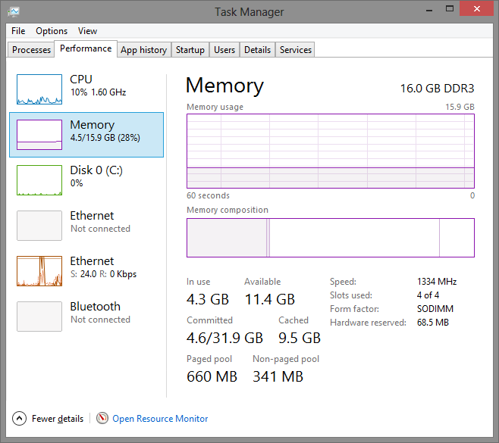
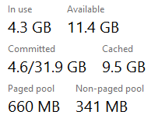
System Commit Charge – Task Manager view
\Memory\Committed Bytes measures the commit charge, which is the total amount of committed memory that is in use by all processes and by the kernel
Commit charge (Committed Bytes)
Commit limit
RAM + Page file
Pagefile.sys
32 GB commit limit
16 GB of RAM
16 GB of page files
Notes:
The system commit charge is the total amount of committed memory that is in use by all processes and by the kernel. This memory might have been guaranteed or written to by a process or by the kernel.
In Task Manager (which part of the OS) (Ctrl + Shift + Esc), the Commit (MB) field shows the system commit charge and the system commit limit.
\Memory\Committed Bytes is the performance counter that measures the system commit charge.
In the example on the slide, the system commit charge is 4.6 GB and the commit limit is 31.9 GB.

Slide 12
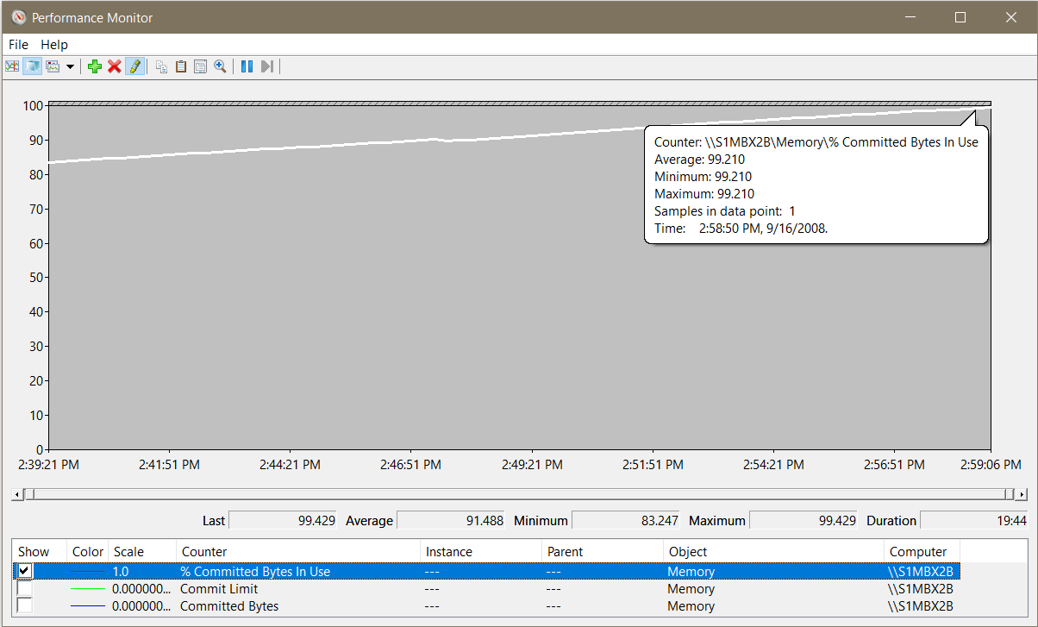
When the Commit Limit is Reached
When the commit limit is reached, the system is out of memory and will hang
You can increase the commit limit by increasing the size of the page file or by adding RAM, but this may only forestalling the inevitable crash if there is a memory leak
Formula: If \Memory\% Committed Bytes In Use reaches near 100, the system is out of physical resources (RAM + page files)
Example:
Here is a Windows Server has a Committed Bytes leak that is depletes the server every 20 hours!
Notes:
Key Points:
When the commit charge reaches the commit limit, the system is out of memory—i.e. it is out of physical resources that can be used to store memory.
The system cannot open new applications or allocate any more memory until either the processes (or kernel resources) using the committed memory release committed memory or the commit limit is increased.
The example in the slide shows a computer that has 4 GB of RAM and a 4 GB page file and that reaches its commit limit. The commit limit is increased by increasing the page file in this case.
Paging files are physical extensions of RAM that store modified data that is not already on the disk. Paging files are needed if the system commit charge is greater than the amount of RAM installed. For example, a system with 4 GB of RAM cannot have a system commit charge above 4 GB unless it has a paging file.
Also:
It is important to know if the system commit charge is close to the system commit limit. If the commit limit is reached, it can cause unexpected errors and poor performance. The % Committed Bytes In Use counter calculates the ratio of committed bytes (commit charge) to the commit limit. This makes it relatively easy for you to determine if the system is low on physical memory resources.
When you are identifying committed-memory conditions, look at all three counters:
% Committed Bytes In Use
Commit Limit
Committed Bytes
For example, % Committed Bytes In Use might stay at 90% when both the Committed Bytes and the Commit Limit increase at the same time. This condition commonly happens when the system is under memory pressure and one or more page files are increased or when RAM is hot-plugged into the system.

Slide 13
Challenge: Question No. 1
Does this computer currently need a page file?
Yes
No
Need more information
Notes:
Based on the information in this section, answer the following question:
Does this computer currently need a page file to support the commit charge?
This is asking if the system commit charge under the Commit (MB) field is larger than RAM.
Yes
No
Need more information

Slide 14
Challenge Question No. 1 (continued)
Does this computer currently need a page file?
Yes
No
Need more information
Answer: B is correct.. Why?
There is 11.4 GB of RAM available..
The commit charge is only 4.6 GB of 16 GB
There is a 16 GB page file (32 GB commit limit – 16 GB RAM = 16 GB page file)
But the page file is not needed because 4.6 GB easily fits into fits into 16 GB of RAM
Put callouts for each Answer “check”..
Notes:
No, this system does not (currently) require a page file, simply because the amount of RAM installed is larger than the system commit charge. This means that all of the system commit charge can fit into RAM.
With that said, this system could benefit from one or more page files to help offset the committed memory load. Many of the committed memory pages might never be needed again and are just taking up valuable RAM, so having a page file to back the page of memory can help keep RAM available when it is needed by more active pages. For example, if there are heavy disk reads and writes, the standby pages (disk cache that is not in use) can be used to avoid going to disk to satisfy the I/O request. This is known as fast I/O.
NOTE: There are certain technologies which DO require a pagefile (Jet database etc)

Slide 15
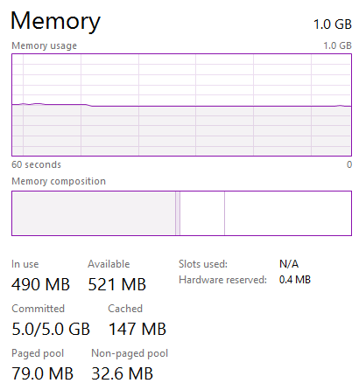
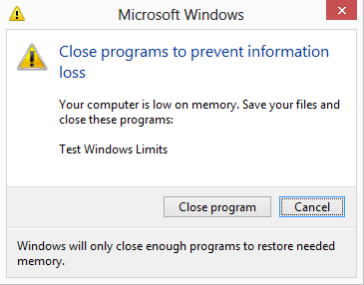
Challenge Question No. 2
What does the error message, Your computer is low on memory, mean?
Processes are out of virtual memory
The kernel is out of virtual memory
The commit limit (RAM + page files) has been reached
Notes:
What does the following error message mean?
Windows – Virtual Memory Minimum Too Low
Your system is low on virtual memory. Windows is increasing the size of your virtual memory paging file. During this process, memory requests for some applications may be denied. For more information, see Help.
Processes are out of virtual memory
The kernel is out of virtual memory
The commit limit (RAM + page files) has been reached

Slide 16
Challenge Question No. 2
What does the error message, Your computer is low on memory, mean?
Processes are out of virtual memory
The kernel is out of virtual memory
The commit limit (RAM + page files) has been reached
Answer: C is correct.. Why?
The commit limit has been reached
Windows is suggesting closing programs to prevent data loss, or it will be forced to close some
Notes:
C is correct.
The commit limit (RAM + page files) has been reached. The OS refers to the paging file as virtual memory, but this is not the same as the virtual memory discussed in Module 3, and the different use of the term commonly leads to confusion.
When the system commit limit is reached, Windows 8 and Windows Server 2012 will identify the application consuming the most committed memory. In this case, the application consuming the most is Test Windows Limits also known as Testlimit which is a Sysinternals tool.
This is global working set trimming and programs like SQL don´t like that

Slide 17
Thresholds of the % Committed Bytes In Use Counter
Suggested Steps
Identify the processes that are consuming the most committed memory, by using \Process(*)\Private Bytes and match the leak lines
If the memory usage is necessary, consider increasing the size of the page file, increasing the amount of RAM, or both
If it is a user mode process leaking memory, leak analysis tools like DebugDiag may help the owners of that process
Thresholds | Effect
0-50% | Informational Normal usage.
60-80%, or more than RAM | Warning Moderate usage. The server might suddenly slow down or hang while the page file is being increased.
80-100% | Critical The server, applications, and services may have poor performance or hang.
Notes:
The \Memory\% Committed Bytes In Use counter calculates the ratio of committed bytes (system commit charge) to the system commit limit, and the system can perform poorly when the system commit limit is reached. Therefore, when % Committed Bytes In Use is greater than 80%, use the \Process(*)\Private Bytes counter to identify the processes that are consuming the most committed memory.
The Debug Diagnostic Tool (DebugDiag) is designed to assist in troubleshooting issues such as hangs, slow performance, memory leaks or fragmentation, and crashes in any user-mode process. The tool includes additional debugging scripts focused on Internet Information Services (IIS) applications, web data access components, COM+ and related Microsoft technologies.
For more information on DebugDiag, go to http://www.microsoft.com/en-us/download/details.aspx?id=26798

Slide 19
What is a page file?

Slide 20
What is a Page File?
A page file is a hidden system file on disk that can be used to simulate physical memory, but is 1-2 orders of magnitude times slower then RAM
If the page file is on an traditional spinning hard drive, then it is 1 million times slower then RAM
If the page files are on an SSD, then it is still 1,000 times slower then RAM
C:\Pagefile.sys
D:\Pagefile.sys
C:\ drive
D:\ drive
Notes:
A page file is a hidden system file on disk that can be used similar to physical memory, but only for modified pages that cannot be found anywhere on disk. This means that the use of a page file is different than physical memory, but it also means that the system can support more committed memory than it would normally be possible with physical memory alone.

Slide 21
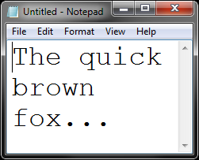
What is in a Page File?
Page files contain only data that is not found anywhere else on the disk
Anything that is already on the disk is not saved to the page file. The .dlls and .exes that are used to launch applications are never in the page file
Unsaved data in Notepad = Potentially pageable data
Pagefile.sys
C:\Pagefile.sys
The quick brown fox…
The .dlls and .exes are already on the disk. Why write them to the disk again?
C:\ drive
Notes:
The text, The quick brown fox jumps over the lazy dog, is private to this instance of Notepad and is not found anywhere on the disk already. This memory is called modified memory. If the system is low on available RAM, the text within this instance of Notepad is the only data that might be found within a page file.
Later, this module will cover the differences between a working set trim and paging.

Slide 22
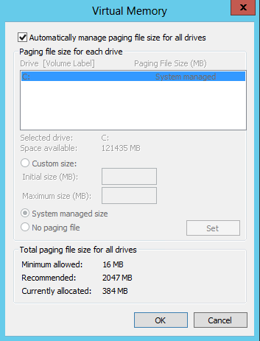
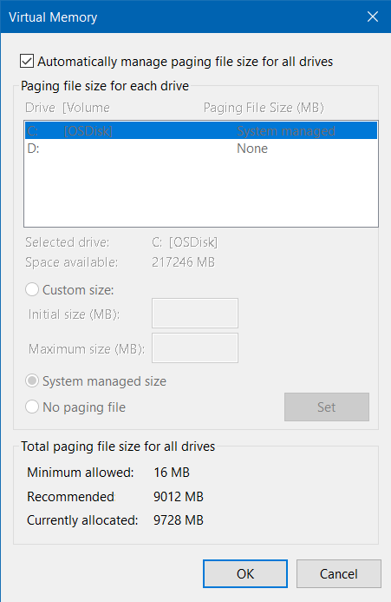
System Managed Paging Files
A page file that dynamically increases and decreases in size to accommodate the system memory demands
Enabled by default on the system partition
Windows Server 2012 R2
Windows Server 2016
Notes:
System managed paging files dynamically increase and decrease in size to accommodate the system memory demands such as the system commit charge and bug checks (crash dumps) also known as a blue screen of death (BSOD). This kind of paging file is enabled by default and it is located on the system partition.
Since system managed paging files will increase and decrease dynamically, it means that the system commit limit can change. This is important when determining when the system commit charge has reached the system commit limit.
Note: The next few slides will discuss the behavior of system managed paging files in each version of Windows and Windows Server.

Slide 23

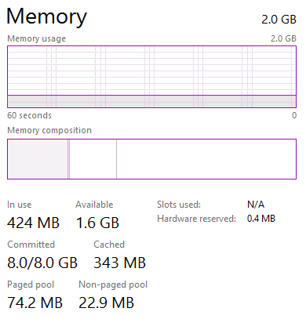
System Managed Paging Files
For Windows 8, Windows Server 2012,
and later versions
Minimum: Depends on several factors
such as:
Physical memory size
History of commit usage
Crash dump settings
Available disk space
Maximum: 3x RAM or 4 GB, whichever is larger
Warning: This can consume more free disk space if there is memory pressure
At minimum
Physical memory
At maximum
Notes:
Key Points:
Due to the concern of the amount of disk space that system managed paging files consume, large RAM sizes, and crash dump settings, the system managed paging file for Windows 8 and Windows Server 2012 has a broad range of sizes that it might need to take. A system with 2 GB of physical memory might initially start with a 400 MB paging file.
If the system crashes, then the paging file might automatically increase to accommodate a larger crash dump. Likewise, if the system is stable for weeks, then the paging file might automatically reduce in size.
The following are the examples of what the initial size of the system managed paging file might be on a system with 2 GB of physical memory and booted with these bug check settings:
Automatic: 400 MB (this size is dependent on many factors)
Small: 128 MB
Kernel: 2 GB (1x RAM)
Complete: 2.2 GB (1x RAM + 200 MB)
The following are the factors that will determine the minimum size of a system managed paging file when the crash dump setting is automatic crash dump. Both of these settings are enabled by default. The minimum size depends on several factors including:
RAM size
History of commit usage
Crash dump settings
Available disk space

Slide 24
Challenge Question No. 3
What portions of this instance of Notepad can be paged out to a page file?
The .dlls and .exes that are used to launch it
The text within it
All of the above
Notes:
Open Notepad.exe and type, The quick brown fox jumps over the lazy dog.
What portions of this instance of Notepad can be paged out to the page file?
The .dlls and .exes that are used to launch it are:
The text within it
All of the above

Slide 25
Challenge Question No. 3
What portions of this instance of Notepad can be paged out to a page file?
The .dlls and .exes that are used to launch it
The text within it
All of the above
Answer: B is correct.. Why?
The .dlls and .exes that are used to launch notepad.exe are already on the disk, so there is no reason to write them to the disk again. But the text is not on the disk, so it can potentially be paged out to a page file
Notes:
What portion of this instance of Notepad can be paged out to the page file?
The correct answer is B—the text within it. All of the portions of .dlls and .exes within Notepad that are used to launch it come from disk, therefore, it would be inefficient to write that data back to the disk.

Slide 27
Crash dumps and the size of the page files

Slide 28
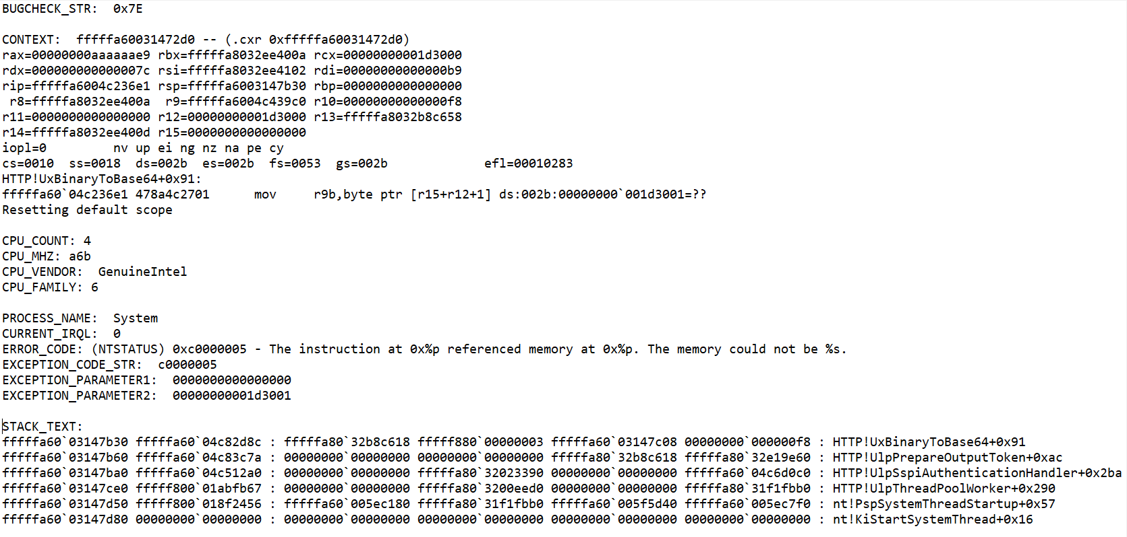
Crash Dump Example
A typical crash dump will have the following elements
Bugcheck code:
Register states
CPU type
and count
Exception
parameters
List of instructions
Performed at the time of the crash

Slide 29
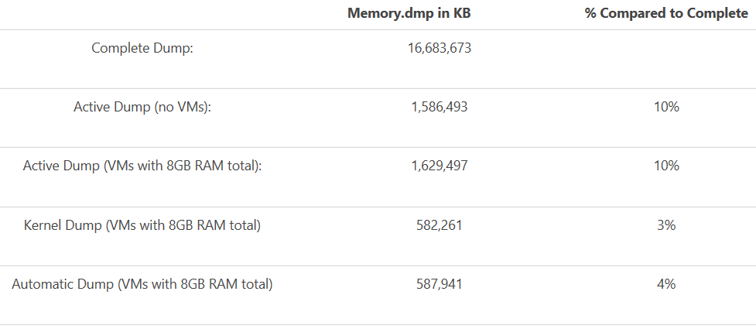
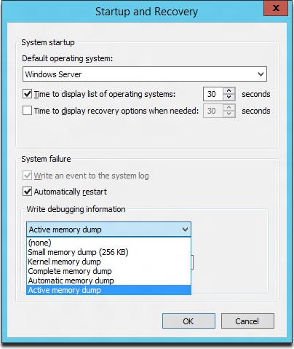
Active Memory dump
A new type of memory dump for Windows 10 and Server 2016
Filters out most memory pages except those in Active Memory for a smaller footprint
TechNet: Active Memory Dump
Notes:
Key Points:
This is primarily used on Hyper-V or Container scenarios for Server 2016 that tend to have a significant amount of RAM.
A complete memory dump includes processor state as well as a dump of what is in RAM and this results in the dmp file for a Full Dump to be extremely large.
On these Hyper-V hosts, the parent partition is usually a small percentage of the overall RAM of the system, with the majority of the RAM allocated to Virtual Machines(VMs).
It’s the parent partition memory that is interesting in debugging a bugcheck or other bluescreen and the VM memory pages are not important for diagnosing most problems.
Windows Server 2016 introduces a dump type of “Active memory dump”, which filters out most memory pages allocated to VMs and therefore makes the memory.dmp much smaller and easier to save/copy.
As an example, I have a system with 16GB of RAM running Hyper-V
I initiated bluescreens with different crash dump settings to see what the resulting memory.dmp file size would be.
I also tried “Active memory dump” with no VMs running and with 2 VMS taking up 8 of the 16GB of memory to see how effective it would be: *The size of the Active Dump as compared to a complete dump will vary depending on the total host memory and what is running on the system.
In looking at the numbers in the table above, keep in mind that the Active Dump is larger than the kernel, but includes the usermode space of the parent partition, while being 10% of the size of the complete dump that would have normally been required to get the usermode space.

Slide 30
Crash Dumps and the Size of the Page Files
Crash dumps record information about the state of the system when the system crashes
This includes CPU register states, pointer instructions, and a list of the last commands executed
During a crash dump the file system is not available, so the disk space reserved by the page file is used
Consider the crash-dump settings when adjusting the minimum size and the placement of the page files
There are (4) types of crash dumps:
Complete memory dump: All physical memory
Kernel & Active memory dumps: Kernel only (typically 1-8 GB), Automatic memory dumps are kernel mode memory dumps where an appropriate page file system size is set to save it
Small or Mini memory dump: Minimal information (typically ~128-356 KB)
Active Memory Dump: Only the Hypervisor memory is captured, not the active RAM of the VM’s
Notes:
Key Points:
Crash dumps record information about the state of the system when the system crashes. Most crash dumps are caused by poorly written device drivers, so it is important to purchase hardware from hardware manufacturers who are known to have reliable drivers and who have passed the Windows logo certification.
During a crash dump, the file system is not available, so the disk space that is reserved by the page file is used. The page file that is targeted for the crash dump is emptied, and the memory that is resident in RAM is written to the page file. After it is written, the pagefile.sys file is renamed to memory.dmp and saved to a pre-designated location in the file system. The default location is the %SystemRoot% directory.
You must consider the crash-dump settings when you adjust the minimum size and the placement of the page files. Each crash-dump setting has its own placement and required size of page files. The next few slides discuss the different types of crash dumps:
Complete memory dump: All physical memory
Kernel memory dump: Kernel only
Small memory dump: Minimal information
Automatic memory dump: Chooses an appropriate dump. This is the default setting.
Articles:
https://support.microsoft.com/en-us/help/254649/overview-of-memory-dump-file-options-for-windows

Slide 31
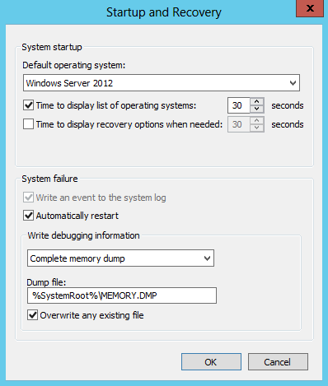
Complete Memory Dump
Records all physical memory at the time of the crash
The page file must have at least:
Minimum: RAM + 1 MB or more
Recommended: RAM + 100 MB recommended
Best for deep analysis with Microsoft Support
This setting is not available on Windows 7 and Windows Server 2008 R2 with 4 GB of RAM or more
Can be enabled via registry modification
Notes:
Key Points:
A complete memory dump records all physical memory (RAM) at the time of the crash and writes it to a page file. The page file that is targeted for the crash dump must exist on a locally attached disk and must be greater than the size of RAM plus 1 MB for the header data.
Therefore, a page file of the size of RAM plus 100 MB is recommended. This is likely the reason why a page file of 1.5x the size of RAM was commonly recommended years ago, but it was not quite accurate for the purposes of a system crash dump.
The Complete memory dump setting is not available on computers with 4 GB of RAM or more running Windows 7 or Windows Server 2008 R2. To enable the complete memory dump option, set the CrashDumpEnabled registry key to 0x1 in the following registry subkey, and then restart the computer:
HKLM\SYSTEM\CurrentControlSet\Control\CrashControl
This setting is available on Windows 8 and Windows Server 2012 regardless of the amount of RAM installed.
For more information on setting page-file sizes, see: How to generate a kernel or a complete memory dump file in Windows Server 2008 http://support.microsoft.com/kb/969028

Slide 32
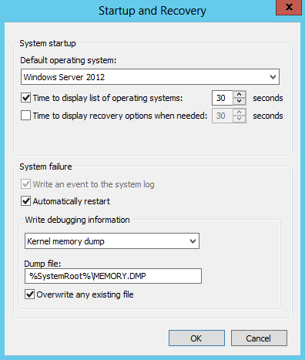
Kernel Memory Dump
Records only the kernel-mode read/write pages that are in physical memory at the time of the crash
Size of page file: Depends on system usage. See the following table for estimates
Estimated minimum size of page file for kernel dumps:
RAM | Minimum size of page file
< 128 MB | > 50 MB
< 4 GB | > 200 MB
< 8 GB | > 400 MB
>= 8 GB | > 800 MB
Notes:
A kernel memory dump records only the kernel-mode read/write pages that are in physical memory at the time of the crash. The required size of the target page file varies based on the memory usage of the kernel at the time of the crash dump. This is the default setting for Windows 7 and Windows Server 2008 R2 with 4 GB or more of RAM. The chart (from the “Windows Internals 6th edition, Part 2” book) in the slide provides estimates of the required minimum size of the target page file based on the amount of RAM installed.

Slide 33
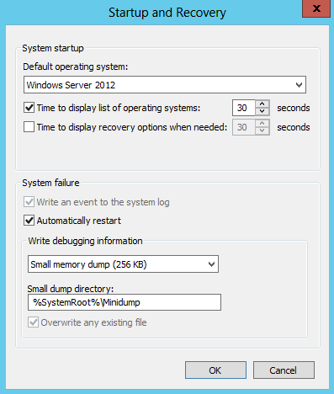
Small Memory Dump
Records only the stop code and parameters, a list of loaded device drivers, and other information
Size of the dump file is typically between 128 KB and 1 MB
The size of the page file must be 2 MB or more on the boot volume
Contains minimal information that might not be helpful
Consider only if disk space is important and there is no history of crash dumps
Notes:
A small memory dump records the stop code and parameters, a list of loaded device drivers, and other information. This amount of data might not be enough for a proper analysis of a system crash dump, but it might provide clues to the cause. The size of the dump file is typically between 128 KB and 1 MB, and requires a page file of 2 MB or more on the boot volume. Use this option only if disk space is limited and there is no history of crash dumps.

Slide 34
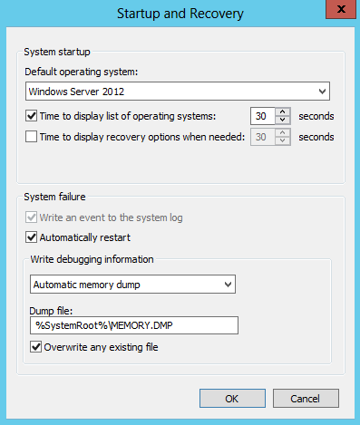
Automatic Memory Dump
This is not a type of memory dump. It chooses a dump type at the time of a bug check depending on heuristics
New feature in Windows 8, Windows Server 2012, and later
Enabled by default
Automatically choses the appropriate dump type
based on:
History of bug checks
Usage of a system managed paging file
The maximum size of the paging file
Free disk space on the system partition
Notes:
The Automatic memory dump option is not really a new memory dump type. In previous versions of Windows and Windows Server, we already have Small, Kernel, and Complete memory dump options. The Automatic memory dump option produces one of the previously mentioned crash dumps depending on how often the system has a bug check.
See the System managed paging files slide earlier in this module on the effects of the Automatic memory dump on system managed paging files.
For more information on automatic memory dumps, see the following blog:
Windows 8 and Windows Server 2012: Automatic Memory Dump
http://blogs.technet.com/b/askcore/archive/2012/09/12/windows-8-and-windows-server-2012-automatic-memory-dump.aspx

Slide 35
Dedicated Dump File
Windows Server 2008 R2 and later support dedicated dump files for crash dumps. It is used to allow crash dump files on non-system disk partitions
A dedicated dump file:
Is a file (*.sys) that is reserved for exclusive use by the system crash-dump routines
Is not used for paging virtual memory
Is similar to a page file in which the system process keeps an open handle to prevent deletion
Can be stored on any local volume that can support a page file
Can be on a SAN or in a sub-folder
Notes:
Key Points:
To get a memory dump in Windows Vista, Windows Server 2008, and later, a paging file does not need to be on the same partition as the partition where the OS is installed. This is a requirement in previous versions of Windows and Windows Server.
To put a paging file on another partition, create a new registry entry named DedicatedDumpFile. You can also define the size of the paging file for the creation of memory dumps by using a new registry key called DumpFileSize.

Slide 36
Dedicated Dump File (continued)
A dedicated dump file can be set by using the following registry keys:
HKLM\System\CurrentControlSet\Control\CrashControl
Name: DedicatedDumpFile
Type: REG_SZ
Value: <Path to the file, such as D:\dumps\dedicateddumpfile.sys>
Name: DumpFileSize
Type: REG_DWORD
Value: <The dump file size in MB>
For more information about dedicated dump files, go to
Windows Server NTDebugging blog http://blogs.msdn.com/b/ntdebugging/archive/2010/04/02/how-to-use-the-dedicateddumpfile-registry-value-to-overcome-space-limitations-on-the-system-drive-when-capturing-a-system-memory-dump.aspx
Notes:
To create the DedicatedDumpFile and DumpFileSize registry entries
Click Start > Run, type Regedit, and then click OK.
Locate and then click the following registry subkey:
HKLM\SYSTEM\CurrentControlSet\Control\CrashControl.
Click Edit > New > String Value.
In the details pane, type DedicatedDumpFile, and then press ENTER.
Right-click DedicatedDumpFile, and then select Modify.
In the Value data field, type <drive>:\<dedicateddumpfile.sys>, and then click OK.
Note: <Drive> is a placeholder for a drive that has enough disk space for the dump file, and <dedicateddumpfile.sys> is a placeholder for the dedicated file and the full path

Slide 38
The Case Of Frequent Hang

Slide 39
Knowledge Check
Which counter helps you determine how big you should make the page file?
What kind of data is written to the page file?
What two factors determine the size of the commit limit?
What happens when the OS reaches the commit limit?
Which counter helps you identify the processes that are using the most committed memory?
Notes:
Question 1 Answer:
The \Memory\Committed Bytes counter helps determine how large the page files should be
Question 2 Answer:
Only modified memory that cannot be found on disk is written to the page files
Question 3 Answer:
The system commit limit is the size of RAM and the total page file size
Question 4 Answer:
When the system commit limit is reached, the operating system will try to increase the size of a page file or hang until committed memory is released
Question 5 Answer:
The \Process(*)\Private Bytes counter shows the amount of private, committed memory in use by a process

Slide 40
Working Sets of Processes

Slide 41
Learnings covered in this Unit
Definition of a working set
Definition of a page fault
Pages/sec
Shared memory

Slide 42
Definition of a working set

Slide 43
Working Sets
A working set is the amount of RAM that a process is using
The \Process(*)\Working Set counter shows the working set of processes
Trimming
If the amount of available memory is within a threshold,* the working set of a process is trimmed casually or not at all
If the amount of available memory is beyond a threshold,* the working set of a process is trimmed aggressively
*As determined by the kernel virtual memory manager. Discussed later in this module.
Microsoft Confidential
Notes:
Every process has a working set. A working set is the amount of RAM that a process is using. The size can vary greatly based on how often the process reads and writes (touches/accesses) memory and based on the memory demands of the entire system. Remember that every process has its own private virtual memory that each application controls, but the working set size of the process is controlled by the kernel. The \Process(*)\Working Set counter measures the working set size of processes.
Process working set sizes are controlled by the kernel and can be trimmed or increased based on the frequency of usage. A process that uses memory aggressively might initially get a large working set, but it is later trimmed by the kernel. Working set trimming can occur at any time, but it might be more or less aggressive based on the availability of RAM.
Working set trimming is described in more detail later in this module.

Slide 44
Definition of a page fault

Slide 45
Page Faults
A page fault occurs when access to a page of memory is attempted, but the page is not in the working set of a process
Virtual
Virtual memory of Excel.exe
RAM
Soft page fault
Working set of Excel.exe
Other RAM
Disk
Hard page fault
Notes:
A page fault occurs when access to a page of memory is attempted, but the page is not in the working set of a process. If the page fault is resolved from elsewhere in RAM, it is a soft page fault. If the page fault is resolved from disk, it is a hard page fault.

Slide 46
Page Faults
A page fault is soft if the page is elsewhere in RAM
A page fault is hard if the page is on the disk
8 GB of RAM
C:\
C:\Docs\Data.doc
Notes:
A page fault occurs when access to a page of memory is attempted, but the page is not in the working set of a process. If the page fault is resolved from elsewhere in RAM, it is a soft page fault. If the page fault is resolved from disk, it is a hard page fault.

Slide 47
Pages/sec

Slide 48
Pages/sec
The Memory\Pages/sec counter indicates the number of hard page faults
Pages/sec is the rate at which pages are read from or written to the disk in order to resolve hard page faults
The Pages/sec counter:
Does not, by itself, indicate a lack of RAM..Why? Since Page File reservations happen all the time when a process wants extra addresses, we map those to the Page File until they need actual RAM
Does not only measure soft page faults
Does Include non-cached mapped memory files (normal file I/O)
A Low Available MBytes value (discussed later in this module), and high Pages/sec, and poor page file response times can indicate a lack of RAM condition
High Pages/sec values but Normal Available Mbytes can mean any of these:
New apps are starting
Memory mapped files (referenced to virtual memory, but the needed parts into RAM)
Page-file read/writes
Microsoft Confidential
Notes:
Key Points:
The \Memory\Pages/sec counter indicates the number of hard page faults. It is the rate at which pages are read from or written to the disk to resolve hard page faults. By itself, it does not indicate a low RAM condition—it simply measures disk access, which might or might not involve the page file.
This counter does not measure soft page faults (page faults resolved from elsewhere in RAM).
Memory-mapped files are commonly used in applications, and the hard page faults that are created by accessing the files are measured in the Pages/sec counter.
The best indicator of a low RAM condition is the \Memory\Available MBytes counter, which is discussed later in this module.
As an experiment, load the \Memory\Pages/sec counter into Performance Monitor, and then open an application that you have not opened before. You should see a high amount of Pages/sec. This is because the portions of the .dlls and .exes that are needed to load the application are not in the working set of the process and must be loaded (resolved) from disk. As you use portions of the application that have not been used yet, more hard page faults occur to read those portions into the working set of the process.
Hard page faults that must be resolved by reading from a page-file (disk) are measured by Pages/sec. Performance Monitor does not have any counters that directly measure page file reads and writes, so it is common to use Pages/sec to indirectly measure page-file access. Pages/sec is not a primary indicator of a low memory condition, simply because it does not directly measure page file reads and because hard page faults are commonly used to read from the disk as part of normal file I/O.
With that said, if the system is in a low RAM condition and if Pages/sec increases in relation to the available RAM, it might be due to page-file access.

Slide 49
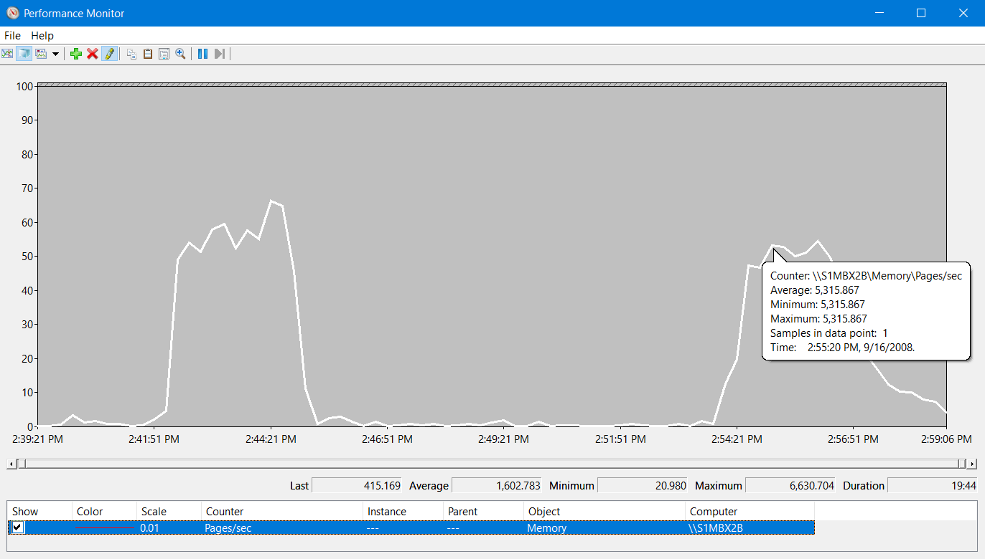
Challenge Question No. 4
Is Pages/sec a primary indicator of a low RAM condition?
Yes
No
Notes:
The \Memory\pages/sec counter measures the number of hard page faults (resolved from disk) that are occurring in the system. Therefore, is it a primary indicator of a low RAM condition?
The chart shows a sustained average of more than 1000 pages/sec (hard page faults).
Yes
No

Slide 50
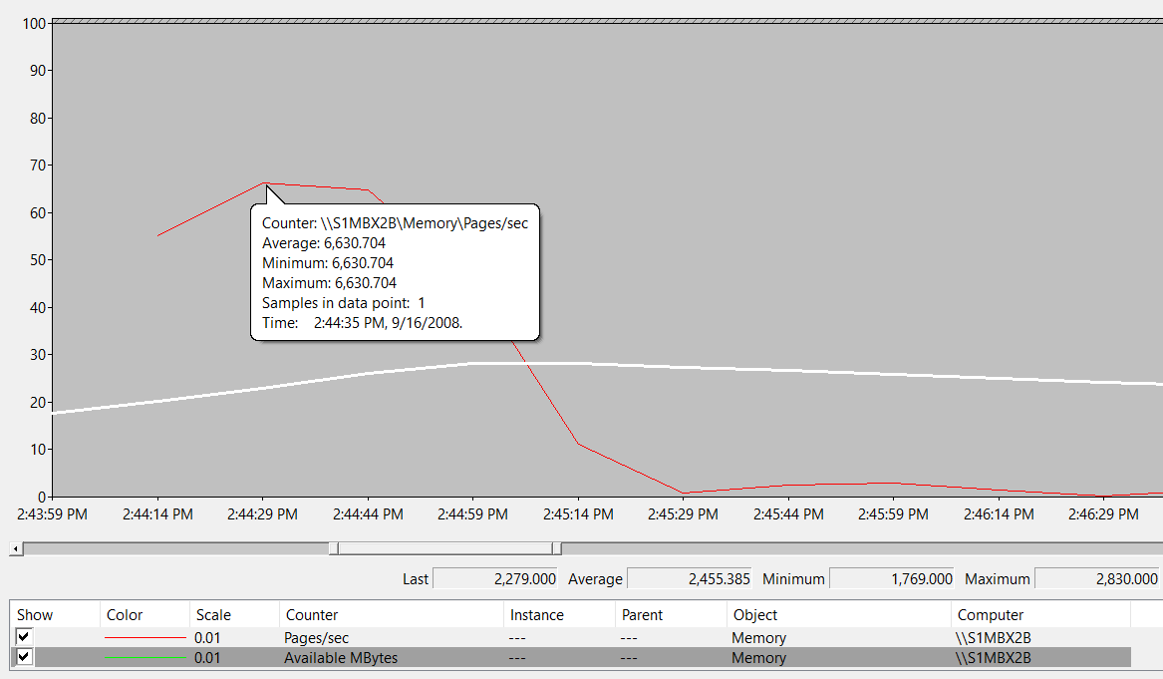
Challenge Question No. 4 (continued)
Is pages/sec a primary indicator of a low RAM condition?
Yes
No
Answer: B is correct
Pages/sec measures hard page faults, which
can be either page-file read/writes or normal disk read/writes from memory-mapped files
In this case, the high Pages/sec is caused by
normal file reads from backup software that is
running during business hours
High Page file activity
But plenty of Available RAM (~2.5 GB)
Notes:
No, in this case the server has at least 1 GB of available RAM when the high numbers of hard page faults are occurring. The hard page faults are caused by normal disk reads from various memory-mapped files from backup software. The backup software mapped each file it targeted into its virtual address space, and then it read each page of memory. Because those pages of memory are not in the working set, they caused hard page faults to read them from disk. A page file was not involved in these hard page faults.
More information was not needed to answer this question because the question asked is, if it is a primary indicator of a low RAM condition.

Slide 52
Shared memory

Slide 53
Shared Memory
Processes with the same execution path to automatically share .dlls and .exes
Processes share portions of .dlls and .exes – just one copy in RAM
Periodically, identical private pages are combined in Windows
This is called Page Combining and can be enabled on Windows 8/Server 2012 to Windows 10/Server 2016
Working set of one instance of Excel.exe (Book1)
Excel.exe
x.DLL
Private data
RAM
Excel.exe
x.DLL
Excel.exe
x.DLL
Private data
Working set of another instance of Excel.exe (Book2)
Notes:
Key Points:
A process automatically shares the portions of .dlls and .exes that are loaded into its working set with other processes of the same execution path, such as two instances of Notepad executed from %windir%\system32\notepad.exe. I.e., if an instance of Notepad.exe is running and another instance is created, it incurs few hard page faults because the instance in RAM likely has most of the memory it needs to launch the new instance.
The new instance simply references to the pages of RAM that the other instance uses, but each instance counts the memory as part of its own working set.
Windows 8/Server 2012 and newer introduce a new feature called page combining. This feature periodically scans process, private, page-able memory and combines the identical pages into a single physical page in RAM freeing up the other physical page(s). If the page is modified by one of the processes, then another page is simply created to accommodate it. The page combining feature is enabled by default on Windows 8, but not on Windows Server 2012. To enable it on Windows Server 2012, open an elevated PowerShell session and run the command, Enable-MMAgent –PageCombining.
Processes can share heap memory, but this is a special case where the developer must specifically manage the memory that is used in this way. In this case, two instances of Microsoft Excel are running. Because they are both from the same executable path, they automatically share all of the portions of .dlls and .exes that are loaded in RAM.
Say you have a single executable (*.exe) that is 200 MB in size—a lot of code. How large is the working set? It is simply as large as it needs to be—meaning that the entire .exe is not loaded into RAM. Only the portions of the .exe that are needed to function are loaded into the working set of the process. Application developers might refer to loading a .dll or .exe into memory.
For more information about shared memory, see the book: Windows Internals 6th edition, Part 2, page 200.
For more information on the Enable-MMAgent command, go to:
http://technet.microsoft.com/library/jj658954.aspx

Slide 54
Knowledge Check
What is the difference between a hard page fault and a soft page fault?
Does the counter Memory\Pages/sec measure hard or soft page faults?
What kind of data is page combined by default between the working sets of processes: .dlls, .exes, or private data?
Notes:
Soft page faults are resolved from RAM, while hard page faults are resolved from disk
Memory\Pages/sec measures hard page faults
Working set pages containing portions of .dlls and .exes are shared by default between processes

Slide 55
Analysis of OS RAM

Slide 56
Learnings covered in this Unit
Memory Leak Terminology
Least recently accessed
Trimming the working set
Available MBytes
The Working Set counter
Commit Limit
Process Memory

Slide 57
Memory Leak Terminology

Slide 58
Memory Leak Terminology
Handle: An object identifier that refers to a resource, such as a file, a window, or a registry key
Thread: An entity within a process that Windows and Windows Server schedules for execution
Resource leak: A condition where a process consumes a resource and retains it unnecessarily, usually after the users have left for the day and yet the resources are not returned to the operating system.
Notes:
Key Points:
Memory leaks can occur for many reasons. They are commonly associated with handles and threads. Handles are actually very small memory structures, but the unnecessary accumulation of resources that the handles refer to is what can cause memory to leak.
Handle: An object identifier that refers to a resource, such as a file, a window, or a registry key
Thread: An entity within a process that Windows and Windows Server schedule for execution
Resource leak: A condition where a process consumes a resource and retains it unnecessarily

Slide 59
Overlay View of How Processes Use Memory
Virtual bytes
Portion of the process address space that is reserved and committed for the process to use
Committed bytes
Portion of the virtual bytes that have been guaranteed resources (RAM + Virtual RAM in the page file)
Private bytes
Portion of the committed bytes that only this process can use (virtual addresses)
Working Set
Portion of the committed bytes that is backed by physical RAM
Process address space
Virtual bytes
Private bytes
Application
Private WS
Committed bytes
Working Set
Shared WS
Shared bytes
Notes:
Key Points:
The difference the between Virtual, Committed, and Working Set memory of a process can easily be confused.
Virtual bytes are the sum of all of the reserved and committed memory of a process, but it cannot exceed the virtual address space of the process. By default, the virtual address space of the process is 8 TB on the x64 versions of Windows and Windows Server. Remember, each process has its own private virtual address space, regardless of the amount of physical resources (RAM and page files) on the computer—meaning that a system can have 100 processes each with its own, private, 8 TB of virtual address space, regardless of the amount of RAM installed.
Committed bytes are the portion of virtual bytes that is in use, meaning that it is guaranteed to the process to be backed by physical resources (RAM and disk in the form of page files).
Private bytes are the portion of committed memory that is private to that instance of the process. This is where memory leaks commonly occur, because it includes the heap memory, which is controlled by the application developer. Private bytes do not include shared bytes, except in the rare case where it is specifically using a shared heap.

Slide 60
Least recently accessed

Slide 61
Least Recently Accessed
Imagine your house is the OS, and items in your home are the working set of processes:
Which item is the oldest? The least recently used?
Note: Memory paging only occurs when the OS has less then 1GB of RAM available. That is why Virtual Machines should have >1 GB of memory during peak loads to avoid paging
Bought: Sept 2010
Last used: Yesterday
Bought: Jan 2010
Last used: Jan 2010
Bought: Mar 1986
Last used: Today
Notes:
Least Recently Accessed:
Imagine that your house is the working set of a process. There are three items of interest in the house: a grill, an exercise bike, and the kitchen sink.
Grill: Bought on Sept 2010, last used yesterday
Exercise bike: Bought on Jan 2010, last used Jan 2010
Kitchen sink: Bought on Mar 1986, last used today
Which item is the oldest in the house based on the date it was bought? Which item was most recently used? Which item was least recently used?
These are the kinds of questions that the Windows memory manager uses to determine which pages of memory are used most often.

Slide 62
Least Recently Accessed
For efficiency, you should move the least recently accessed items to slower media – Like stale 4k memory pages to the Page File
The exercise bike is not the oldest item, but it is the least recently accessed item, and should be paged out to the garage
Bought: Sept 2010
Last used: Yesterday
Bought: Jan 2010
Last used: Jan 2010
Bought: Mar 1986
Last used: Today
This item should be put in the garage (paged out)
Notes:
The exercise bike is the item that was least recently used or accessed. I.e. the bike is taking up valuable floor space in the house, yet it is rarely used. This item is the best candidate to put in the garage. We are not getting rid of it; we are simply putting it in storage that takes longer to access, in favor of freeing up floor space in the house. The exercise bike is certainly not the oldest item in the house, but it was the item least recently used, so it might not need to be in the house.

Slide 63
Trimming the working set

Slide 64

Trimming a Working Set
For efficiency, the least recently accessed pages (not the oldest ones) are paged out first
If the data in the page is:
Not already on the disk—it is paged out to the page file and removed from the working set
Already on the disk—it is removed from the working set and is not paged out
Working set of Excel.exe
Created: 2:30 P.M. Last accessed: 2:50 P.M.
Created: 1:00 P.M. Last accessed: 1:10 P.M.
Created: 9:00 A.M. Last accessed: 3:40 P.M.
Current time is 3:49 P.M.
This is the least recently accessed page. It is paged out first
Notes:
Like the example with the exercise bike, the Windows memory manager uses the least recently accessed date when it selects pages to trim. When it trims the working set of a process, the memory manager determines whether the page of memory is already on disk or not. If it is not already on disk, it is considered modified memory and must be written (backed up) to disk before it can be removed from the working set.
Modified pages that are written to disk in this way are written to a page file. If the page of memory is already on disk (meaning that it can be retrieved from disk if it is needed again), the page is simply removed from the working set, allowing that memory to be used for data that is more frequently accessed.

Slide 65
Available MBytes

Slide 66
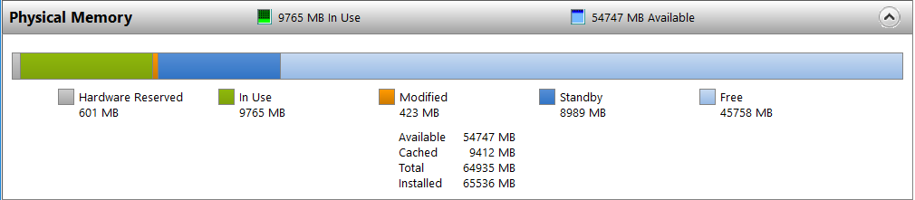
Available MBytes
Memory\Available Mbytes counter:
Measures the amount of physical memory (RAM), in megabytes, that is immediately available for allocation either to a process or for system use
It is the sum of the Zero, Free, and Standby page lists of the Memory Manager
Low Available MBytes is a primary indicator of a low RAM condition
This counter will correlate with standby page life expectancy, hard page faults, page file usage, and disk latency issues
Example: a 64 GB Server: 54767 Available + 9765 In Use = 64 GB Installed
45758 MB free memory pool + Standby memory pool = 54 GB Available
Notes:
Key Points:
The \Memory\Available MBytes performance counter measures the amount of physical memory (RAM), in megabytes, that is immediately available for allocation either to a process or for system use. It is the sum of the Zero, Free, and Standby page lists discussed earlier.
When the Available MBytes counter is low, it is a primary indicator of a low RAM condition. This is when aggressive working set trims will occur which may or may not result in a hard page fault where the pages on the Modified list are written to disk.
The \Memory\Pages/sec counter measures hard page faults, but it does not distinguish between hard page faults that result from normal file reads or writes and page file reads or writes. Therefore, use Pages/sec together with the Available MBytes counter, and do not use Pages/sec by itself.

Slide 67
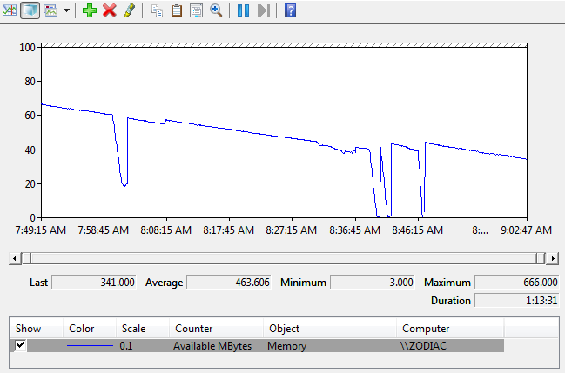
Available Mbytes exhaustion example
Notice that this server exhausts RAM (3) times in 73 minutes and drops all the way down to only 3MB of RAM left, causing a paging storm
Decreasing trend
8:39 A.M. to 8:40 A.M.
8:00 A.M.
Notes:
In this example, the system is on a decreasing trend of available memory (RAM), and it spikes down to 3 MB. This system has 1 GB of RAM installed, so 3 MB is less than 1% of the RAM installed. When the system is this low on available memory, it aggressively trims working sets, likely resulting in increased disk usage and longer delays as a result of waiting on the disk.

Slide 68
Thresholds for Available MBytes
Common next steps:
Identify the processes that are consuming the most RAM, by using \Process(*)\Working Set
The only permanent solution is to scale up by adding more RAM (Scale Up), or move some of the load to another server that has spare RAM capacity (Scale Out)
If the affected OS is a VM, then increasing Installed Memory or enabling the “Use Dynamic Memory” switch will allow the VM to scale it’s RAM to actual use
Threshold | Effect
2 GB or more of RAM | Informational Normal usage
1+ GB of RAM | Warning High memory usage and low disk cache, the OS will sense this low memory condition and may begin to trim application working sets
<1 GB of RAM | Critical Memory exhaustion, which can cause excessive paging, high disk I/O, and extremely poor performance of the server, applications, and services. Process working sets and the File Cache will be trimmed
Notes:
Key Points:
If the system has no more than 1% or 1000 MB of RAM available, the system is in a low memory [RAM] condition. That is to say, the Zero, Free, and Standby page lists are nearing depletion, that the Modified list must be aggressively written to disk, and that the working sets must be aggressively trimmed to replenish the Standby and Modified lists.
This results in high disk activity while the pages on the Modified list are written to disk and moved to the Standby list, where they become available RAM. Remember, pages on the Standby list are already on disk and available for reuse, but pages on the Modified list must be written to disk before they can be reused.
Use DebugDiag to track processes that are leaking memory http://www.microsoft.com/downloads/details.aspx?familyid=4A2FBD0D-0635-440C-A08B-ED81BDBB5960

Slide 69
Private Bytes
The \Process(*)\Private Bytes counter measures how much private, committed memory a process is currently using
This memory is private to that process—no other process can use this memory
The \Process(*)\Private Bytes is the best counter for identifying process memory leaks
Notes:
You can use the \Process(*)\Private Bytes counter to measure the amount of private, committed memory that is in use by a process. If one or more processes are consuming large amounts of committed memory, consider using a tool like DebugDiag (a free tool from Microsoft.com) or VMMap.exe (http://live.sysinternals.com/vmmap.exe) to identify how the memory is being used within the target process.

Slide 70
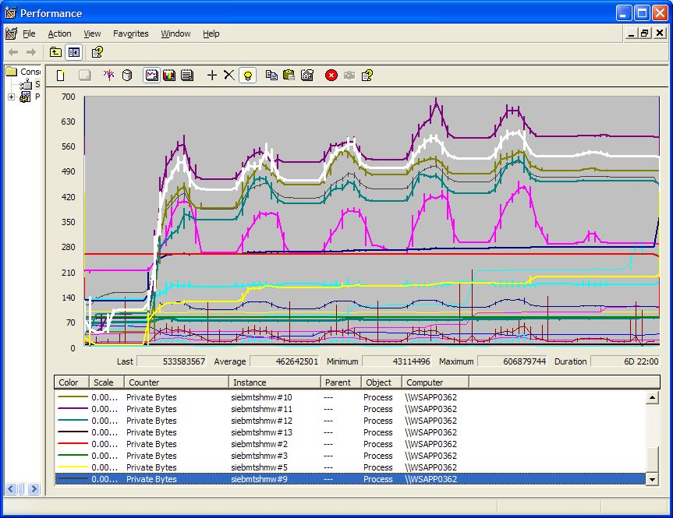
Private Bytes Memory Leak example
Code for an IIS plug-in was leaking private bytes, due to a handle leak. Notice that Private Bytes increased at each instance of allocation and de-allocation over a 5 day period
Slowly increasing trend in Private Bytes over time (6 days)
Notes:
In the example on the slide, several processes are leaking private bytes over a long period of time (seven days). When a process becomes busy, it is normal for the process to consume memory to get the job done. This happens each business day. Then, the process goes idle and de-allocates its memory. But, over time, the process accumulates memory and does not release all of it, resulting in a memory leak over a long period of time.

Slide 72
The Working Set counter

Slide 73
Working Sets
A working set is the committed bytes that a process has resident in RAM
The Process(*)\Working Set counter shows memory consumed per process
If the amount of Available Memory is typically 1 GB free, the working set of a process is trimmed casually or not at all
If the amount of Available Memory is below 1 GB free, the working set of a processes are trimmed aggressively
*As determined by the kernel virtual memory manager
Notes:
Working Sets:
Every process has a working set. A working set is the amount of RAM that a process is using. The size can vary greatly based on how often the process reads and writes (touches/accesses) memory and based on the memory demands of the entire system. Remember that every process has its own private virtual memory that each application controls, but the working set size of the process is controlled by the kernel. The Process(*)\Working Set counter measures the working set size of processes of all counters.
Process Working Set sizes are controlled by the kernel and can be trimmed or increased based on the frequency of usage. A process that uses memory aggressively might initially get a large working set, but it is later trimmed by the kernel. Working set trimming can occur at any time, but it might be more or less aggressive based on the availability of RAM.
Shared bytes are the automatically shared portions of .dlls and .exes that are needed for the application to function. In rare cases, shared bytes might include heaps that are specifically shared with other processes.
Working set is the portion of committed bytes that is resident in RAM. This includes the automatically shared (non-private) portions of .dlls and .exes that are needed for the process to function and (rarely) the portions of a shared heap, if specifically used.

Slide 74

Working Set vs. Private Bytes
The Process(*)\Private Bytes counter:
Is the best counter for detecting committed memory leaks
Includes all of the committed memory of a process, no matter if the memory is in RAM (working set) or on the disk (page file)
Example:
Zune has a Private Bytes of 184 MB of virtual memory requested, but only Working Set of 71 MB of actual memory consumed
Testlimit shows 4.2 GB of address space request (Private Bytes), but only 28 MB of actual memory consumed (Working Set)
4 GB of virtual address space
Only 71 MB of RAM consumed
Notes:
Key Points:
Since the working set size is determined largely by the frequency of memory access, it by itself does not indicate the amount of committed memory that the process is using.
In some cases, as a process consumes a page of memory into its working set, the memory manager might trim a page that is less recently accessed from the working set for that process, so the working set stays the same while private bytes continues to grow. Thus, the indicator of a memory leak is best viewed in the committed memory (physical resource commitment but generally not used) that is using Private Bytes.

Slide 75
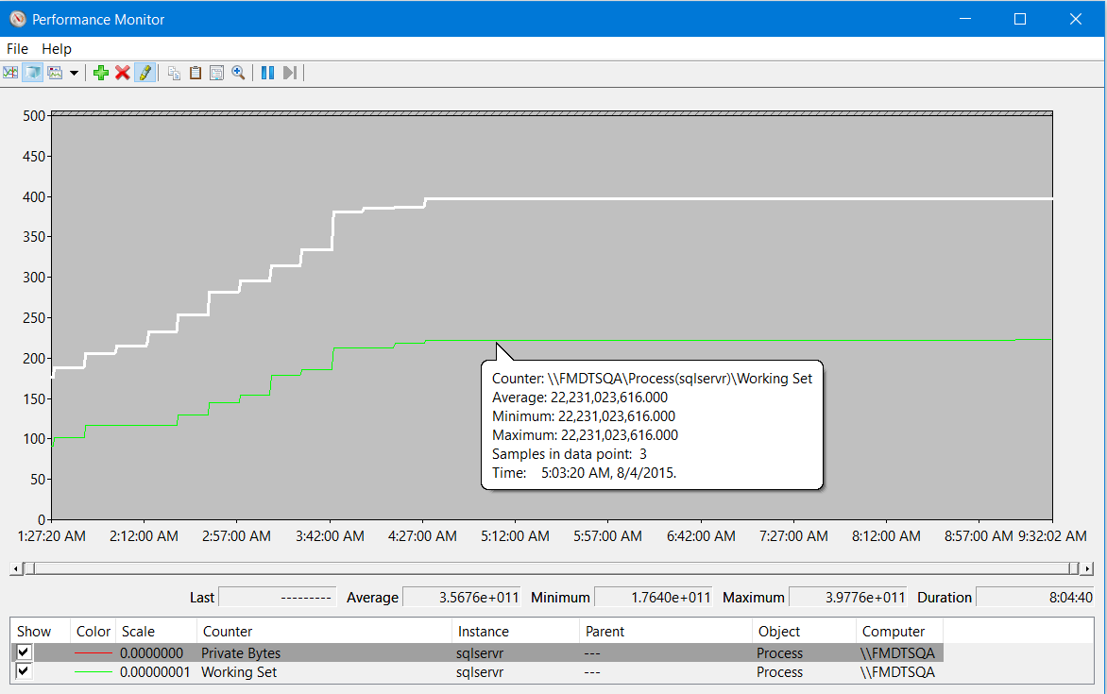
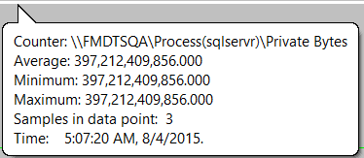
Working Set vs. Private Bytes
Working set is the amount of RAM that that Process is using, Private Bytes is the amount of virtual memory that have been reserved, but may not be consuming physical RAM
Example: Notice that process SQLServ has requested 397.2 GB of Private Bytes (white line), but is only really using 22.3 GB of it as Working Set (green line)
Notes:
Working Sets:
Every process has a working set. A working set is the amount of RAM that a process is using. The size can vary greatly based on how often the process reads and writes (touches/accesses) memory and based on the memory demands of the entire system. Remember that every process has its own private virtual memory that each application controls, but the working set size of the process is controlled by the kernel. The \Process(*)\Working Set counter measures the working set size of processes.
Process working set sizes are controlled by the kernel and can be trimmed or increased based on the frequency of usage. A process that uses memory aggressively might initially get a large working set, but it is later trimmed by the kernel. Working set trimming can occur at any time, but it might be more or less aggressive based on the availability of RAM.
Working set trimming is described in more detail later in this module.

Slide 76
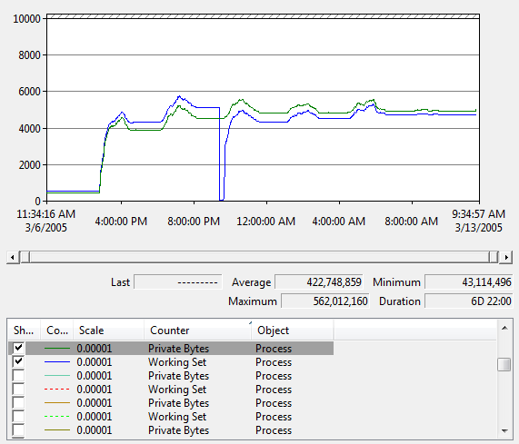
Private Bytes and Working Set example
Notice this process has had its Working Set trimmed, but not Private Bytes
Working Set (blue) is trimmed, but Private Bytes (green) continues to leak
Notes:
This slide shows a process that is leaking memory for seven days. The green line is the private bytes of the process, and the blue line is the working set of the same process. As the process becomes idle, its working set is trimmed by the memory manager. When the process becomes active again, the working set is increased, based on the memory that the process accessed.

Slide 77
Thresholds for the Working Set Counter
Threshold | Effect
10% or more of available RAM | Informational Normal usage.
Less than 10% of available RAM and 60-80% of combined working sets* | Warning Moderate memory usage, which warrants monitoring. Identify the processes that are consuming most Working Set or that are increasing. Consider restarting these processes while usage is low.
Less than 1% of available RAM, 80% or more (combined*) of the working set, and increasing trends over a long period of time | Critical Heavy memory usage, which warrants monitoring. Identify the processes that are consuming the most private bytes or that are increasing over a long period of time. Consider restarting these processes while usage is low, contacting Microsoft Support, and using DebugDiag.†
Notes:
Key Points:
If the system is low on available memory (RAM), check the \Process(_Total)\Working Set counter to determine whether one or more processes are consuming a large portion of RAM. If the \Process(_Total)\Working Set counter does not account for the RAM usage, look at the Memory counters to determine if the kernel is consuming the RAM.
For example, the System Cache (measured by \Memory\System Cache Resident Bytes) might consume RAM.
*\Process(_Total)\Working Set compared to the available RAM
†http://www.microsoft.com/downloads/details.aspx?familyid=4A2FBD0D-0635-440C-A08B-ED81BDBB5960

Slide 78

Demonstration
Process\Private Bytes and Process\Working Set counters

Slide 80
Commit Limit

Slide 81
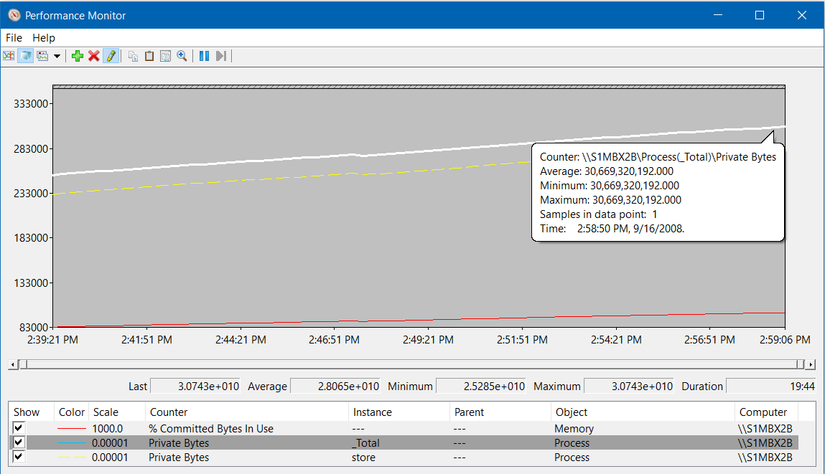
Commit Limit is Reached – Kernel or User mode?
When the commit limit is reached, the system is out of memory and will hang
You can increase the commit limit by increasing the size of the page file or by adding RAM, but this may only forestalling the inevitable crash if there is a memory leak
Formula: If \Memory\% Committed Bytes In Use reaches near 100, the system is out of physical resources (RAM + page files)
Example:
Here is a Windows Server has a Committed Bytes leak from a User mode process that depletes the server every 20 hours!
Notes:
Key Points:
When the commit charge reaches the commit limit, the system is out of memory—i.e. it is out of physical resources that can be used to store memory.
The system cannot open new applications or allocate any more memory until either the processes (or kernel resources) using the committed memory release committed memory or the commit limit is increased.
The example in the slide shows a computer that has 4 GB of RAM and a 4 GB page file and that reaches its commit limit. The commit limit is increased by increasing the page file in this case.
Paging files are physical extensions of RAM that store modified data that is not already on the disk. Paging files are needed if the system commit charge is greater than the amount of RAM installed. For example, a system with 4 GB of RAM cannot have a system commit charge above 4 GB unless it has a paging file.
Also:
It is important to know if the system commit charge is close to the system commit limit. If the commit limit is reached, it can cause unexpected errors and poor performance. The % Committed Bytes In Use counter calculates the ratio of committed bytes (commit charge) to the commit limit. This makes it relatively easy for you to determine if the system is low on physical memory resources.
When you are identifying committed-memory conditions, look at all three counters:
% Committed Bytes In Use
Commit Limit
Committed Bytes
For example, % Committed Bytes In Use might stay at 90% when both the Committed Bytes and the Commit Limit increase at the same time. This condition commonly happens when the system is under memory pressure and one or more page files are increased or when RAM is hot-plugged into the system.

Slide 82
Thresholds of the % Committed Bytes In Use Counter
Suggested Steps
Identify the processes that are consuming the most committed memory, by using \Process(*)\Private Bytes and match the leak lines
If the memory usage is necessary, consider increasing the size of the page file, increasing the amount of RAM, or both
If it is a user mode process leaking memory, leak analysis tools like DebugDiag may help the owners of that process
Thresholds | Effect
0-50% | Informational Normal usage.
60-80% | Warning Moderate usage. The server might suddenly slow down or hang while the page file is being increased.
80-100% | Critical The server, applications, and services may have poor performance or hang.
Notes:
Key Points:
The \Memory\% Committed Bytes In Use counter calculates the ratio of committed bytes (system commit charge) to the system commit limit, and the system can perform poorly when the system commit limit is reached. Therefore, when % Committed Bytes In Use is greater than 80%, use the \Process(*)\Private Bytes counter to identify the processes that are consuming the most committed memory.
The Debug Diagnostic Tool (DebugDiag) is designed to assist in troubleshooting issues such as hangs, slow performance, memory leaks or fragmentation, and crashes in any user-mode process. The tool includes additional debugging scripts focused on Internet Information Services (IIS) applications, web data access components, COM+ and related Microsoft technologies.
For more information on DebugDiag, go to http://www.microsoft.com/en-us/download/details.aspx?id=26798

Slide 83
Demonstration
Show Memory\Committed Bytes Leak vs. Process\(*)\Private Bytes

Slide 84
Process Memory

Slide 85
Significant Resource Usage
Look for significant resource usage in thread counts and handle counts
Examples that are worthy of Investigation:
Counter | Threshold to investigate
\Process(*)Private Bytes | 1500 MB delta between Min and Max
\Process(*)\Working Set | 1500 MB delta between Mix and Max
\Process(*)\Thread Count | 1000 thread delta between Min and Max
\Process(*)\Handle Count | 1000 handle delta between Min and Max

Slide 86
Troubleshooting Application-memory Leaks
Memory allocations of the processes must be monitored over time
If \Memory\% Committed Bytes In Use is high, use \Process(*)\Private Bytes to determine which processes are consuming the most committed memory and whether those processes are increasing over a long period of time
Consider using a memory-leak analysis tool, such as:
Debug Diag: A free tool from Microsoft that attaches to a process and records memory allocations as they occur http://www.microsoft.com/downloads/details.aspx?FamilyID=28bd5941-c458-46f1-b24d-f60151d875a3
VMMap: A free tool from Windows Sysinternals that shows the memory usage of a process http://technet.microsoft.com/sysinternals/dd535533.aspx
Notes:
Key Points:
In review, first determine whether the system is in danger of reaching the system commit limit or at least if it is on an increasing trend over a long period of time. The \Memory\% Committed Bytes In Use, \Memory\Committed Bytes, and \Memory\Commit Limit counters can help with this. After you detect a system committed-memory leak, analyze the \Process(*)\Private Bytes counter to identify which process or processes are using the most committed memory.
Consider using tools such as DebugDiag and VMMap to determine what the memory resources look like inside of the targeted processes.
DebugDiag: A free tool from Microsoft that attaches to a process and records memory allocations as they occur http://www.microsoft.com/downloads/details.aspx?FamilyID=28bd5941-c458-46f1-b24d-f60151d875a3
VMMap: A free tool from Windows Sysinternals that shows the memory usage of a process http://technet.microsoft.com/sysinternals/dd535533.aspx

Slide 87
The Case of the Slow Leak

Slide 88
Microsoft

